Slide 1
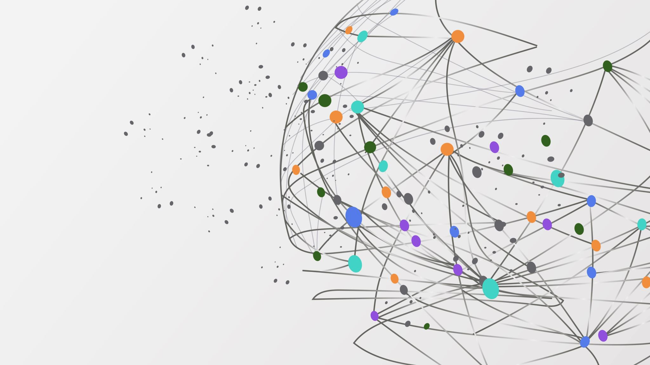
Retail Store Data Science Project
Mohamed Gamal

Slide 2
Introduction
Data science is revolutionizing the way retailers do business. By collecting and analyzing data from various sources such as sales data, customer data, and inventory data, retailers can gain valuable insights into consumer behavior and preferences. These insights can be used to optimize pricing strategies, improve customer experience, and increase sales. In this presentation, we will explore the different ways in which data science is being used in retail stores and discuss some of the key benefits it provides.

Slide 3
Data Collection
Data collection is an essential part of data science in retail stores. By collecting data from various sources such as sales, customer, and inventory data, retailers can gain valuable insights into consumer behavior and preferences. This information can be used to optimize pricing strategies, improve customer experience, and increase sales. Retailers can collect data through various methods such as point-of-sale systems, customer surveys, loyalty programs, and retail tracking. The collected data can then be analyzed using various data science techniques such as machine learning and predictive analytics to derive insights that can help retailers make informed decisions.

Slide 4
Data Analysis
Data analysis is a crucial component of data science in retail stores. By analyzing the data collected from various sources such as sales data, customer data, and inventory data, retailers can gain valuable insights into consumer behavior and preferences. This information can be used to optimize pricing strategies, improve customer experience, and increase sales. Retailers can use various data analysis techniques such as descriptive, predictive, and prescriptive analytics to derive insights from the collected data. These insights can help retailers make informed decisions that can drive business growth.

Slide 5
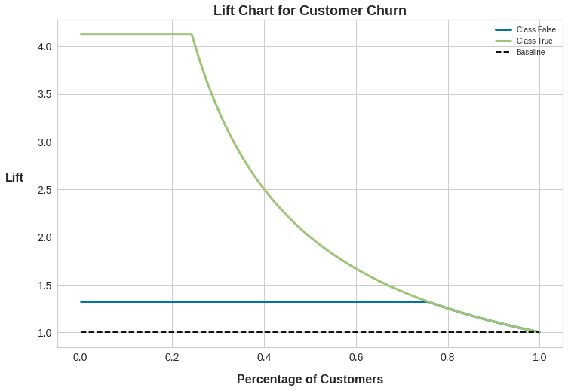
Lift chart about percentage of Customers

Slide 6
Use Cases
Data science has numerous use cases in retail stores. One of the most common use cases is demand forecasting, which involves predicting the demand for products based on historical sales data and other factors such as seasonality and promotions. Another use case is customer segmentation, which involves dividing customers into different groups based on their behaviour and preferences. This information can be used to create targeted marketing campaigns and improve customer experience. Other use cases of data science in retail stores include inventory optimization, pricing optimization, and fraud detection.

Slide 7
Conclusion
In conclusion, data science has become an integral part of retail stores. By collecting and analyzing data from various sources such as sales data, customer data, and inventory data, retailers can gain valuable insights into consumer behavior and preferences. These insights can be used to optimize pricing strategies, improve customer experience, and increase sales. Data science techniques such as machine learning and predictive analytics can be used to derive insights from the collected data. Retailers can use these insights to make informed decisions that can drive business growth.

